Slide 1
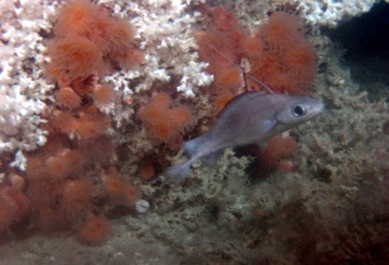
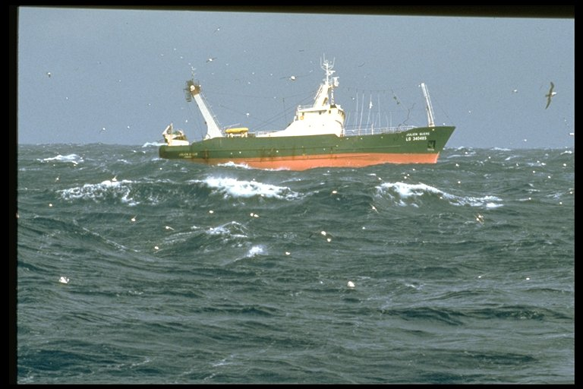
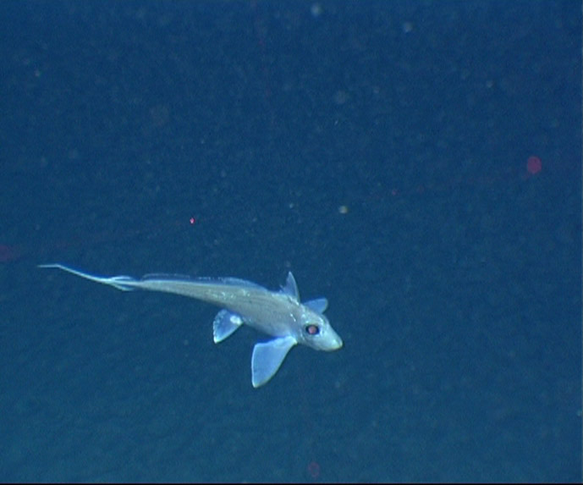
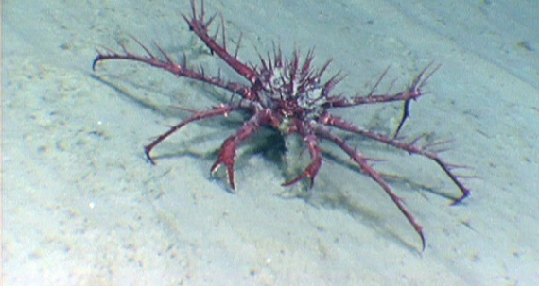
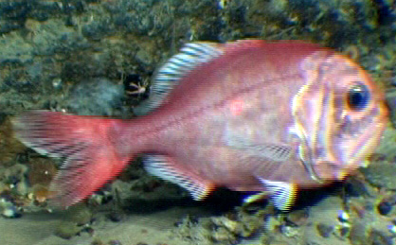
DEEPFISHMAN
Management and monitoring of deep-sea fisheries and stocks
EU FP7 project
grant No 227390
Pascal Lorance (project coord.) Pascal.lorance@ifremer.fr

Slide 2
DEEPFISHMAN project
13 partners from 9 countries
3 millions Euros EC contribution
April 2009 - September 2012
Case studies
Black scabbardfish (West Portugal)
Redfish (Iceland & Norwegian Sea)
Greenland halibut (NAFO area)
Orange roughy (Namibia & Ireland)
Blue ling (West of BI)
Blackspot sea bream (Gibraltar, Bay of Biscay, Ionian Sea)
Mixed species trawl fishery (West of BI)

Slide 3
General aims
Develop
  Stock assessment methods
  Biological reference points (BRPs)
  Harvest control rules (HCRs)
  Managements strategies
  Monitoring requirements
Account of
  Stock sensitivity
  Biodiversity/ecosystem and VMEs sustainability and conservation
  Socio-economic profiles of fisheries
Using
  Experience in other areas
  Case study data and knowledge
  Stakeholder consultation

Slide 4
Areas of DEEPFISHMAN progress
Economics of deep-water fisheries
Definition of deep-water environment and species
Definition of deep-water fishing effort, management implications of observed effort distribution
Deep-water fish stock assessment methods
Steps towards an ecosystem approach
Monitoring and management framework
Project publications
Future research needs for deep-water fisheries, stocks and ecosystems

Slide 5
Economics of deep-water fisheries
Results of simulation modeling of deep-water fisheries
Transferable fishing rights (ITQs) are more efficient for the management of deep-water fisheries
Results of stakeholder consultation
Stakeholders are not in favour of ITQs
  NGOs and small scale fishery sector fear the appropiation of resources by large companies
  Large scale fishery sector thinks ITQs will not bring any change
DEEPFISHMAN deliverables 3.2, 3.3 and 7.4
Agnarsson S. & Stefansson, A.S., (in prep.). Effective management of deep-sea species: The Icelandic redfish fishery in the Irminger Sea. Symposium Ecosystem based management and monitoring in the deep Med. & N. Atlantic, Galway, Ireland, August 28-31 2012.
Notes:
open-access or intensity managed with common property problem not addressed exhaust most stocks
ITQs lead to more stable catches

Slide 6
Definition of deep-water species and environments
DEEPFISHMAN proposal
Deep-water habitat: below 200 m
Deep-water fish species: species with more than 50% of the biomass distributed deeper than 200 m
EU vessel licensing: combination of annex I and II with some adjustment
Notes:
In some areas of the NE Atlantic deep-water species be defined as those which spend a significant part of their life-cycle at depths >200 m and have 50% or more of their adult biomass occurring at depths >200m.
The appropriateness of 200 m depth limits should be evaluated for all areas.
In line with the FAO guidelines for the management for deep-sea fisheries in the high-seas Deep-water fisheries are those which
i. the total catch (everything brought up by the gear) includes
species that can only sustain low exploitation rates; and
ii. the fishing gear is likely to contact the seafloor during the normal
course of fishing operations.
Definition of deep-water fish may require adjustment for area with narrow shelf
EU lincensing: list of species in annex I and II mostly consistent with the criteria of 50% deeper than 200 m
Adjustment: remove conger eel (Conger conger) and Norway redfish (Sebastes viviparus) removed and Greenland halibut (Reinhardtius hippoglossoides), tusk (Brosme brome) and beaked redfish (Sebastes mentella) included

Slide 7
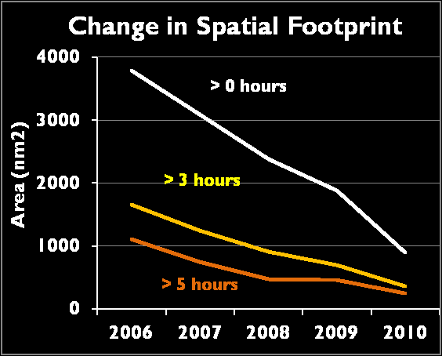
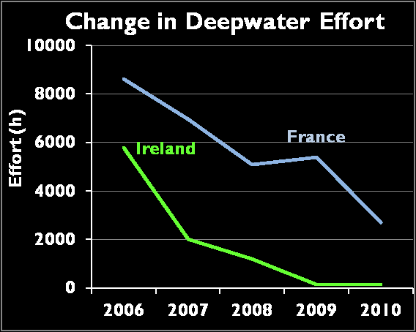
Definition of deep-water fishing effort
UK VMS data
French deep-water fleet >800 m
Irish VMS data
Notes:
Deepfishman results show that a relatively small proportion of the total fishable area is actually fished in the deep sea. Results show that typically only 20% of fishable area at depths between 200 and 800m is actively fished whereas at depths >800m this figure is substantially reduced to 1%. By comparison results for shelf areas <200m in depth show that typically 40% of the fishable area is actively fished. To the West of the British Isles fishing activities under the current deep-sea fishing permit are distributed mostly below 800 m
Effort of fleets licensed under regulation 2347/2002 is only a small fraction of effort at slope depths
Impacts on bottom habitats are observed in areas with no fishery regulated under 2347/2002 (e.g. Bay of Biscay, impacts observed in CoralFISH)
Other fishery at slope depth make up
- Deep-water fishing effort can be efficiently estimated from VMS

Slide 8
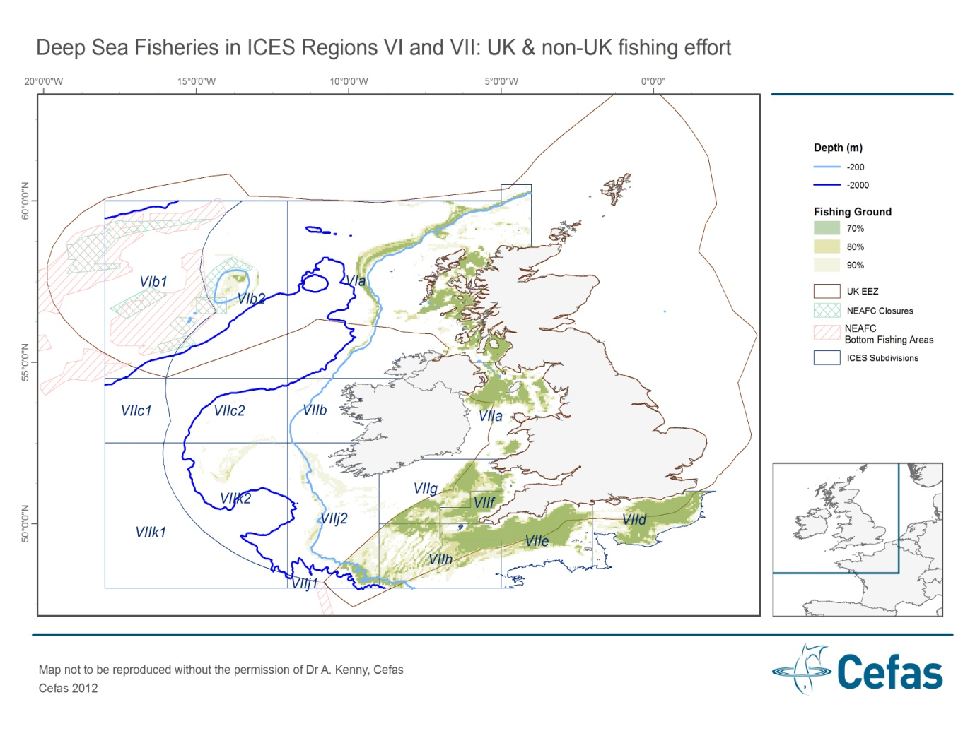
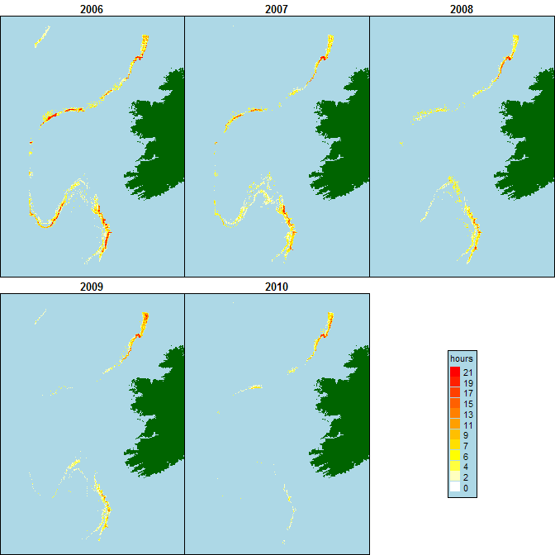
Spatial and temporal distribution of deep-water fishing from VMS
UK waters
Irish waters
Deep-water fisheries

Slide 9
Deep-water fish stock assessments
Stock assessments are essential for PCP and MSFD to manage at MSY
Challenging for data poor stocks
Wide range of situations labelled « Data poor »
Deep-water stocks not necessarily data-poor
DEEPFISHMAN contribution: Data collation to improve stock diagnostics
DEEPFISHMAN contribution: New assessment methods
Notes:
Stock assessment is essential to fisheries management, in particular the objectives in the PCP and MSFD to manage stock in a MSY framework implies

Slide 10
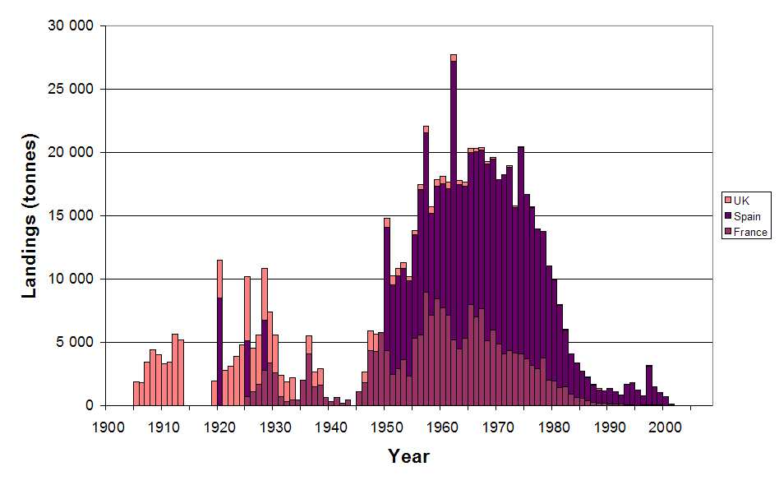
Data collation
Red sea bream in the Bay of Biscay
DEEPFISHMAN diagnostic
Depleted rather than data poor
State of stock clear: collapsed
Management can only aim at rebuilding; current management appropriate
Yield per recruit
Population dynamics
Lorance, P. 2011. History and dynamics of the overexploitation of the blackspot sea bream (Pagellus bogaraveo) in the Bay of Biscay. ICES Journal of Marine Science, 68: 290-301.

Slide 11
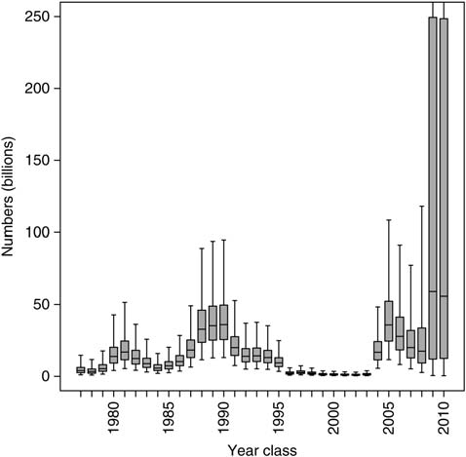
Data collation
Reconstructing beaked redfish recruitment
Statistical model
- Numbers-at-age in the population and observation in 4 surveys
- Ages 0 to 15
Reconstructed time series of year-class strength
Model has been further developed for full stock assessment
Planque, B., Johannesen, E., Drevetnyak, K. V., and Nedreaas, K. H. 2012. Historical variations in the year-class strength of beaked redfish (Sebastes mentella) in the Barents Sea. ICES Journal of Marine Science, 69: 547-552.
Notes:
Year-class strength:=effective number of 0-group fish = strength of year-class that entered in the fishery
Now used in assessment of beaked redfish in ICES I and II

Slide 12
DEEPFISHMAN new methods
Stock assessment methods
Multi-annual year class curves (age based)
Bayesian state space model of black scabbardfish and deep-sea sharks (two-stages)
Bayesian production model for roundnose grenadier
GADGET toolbox for Icelandic blue ling
Simulation testing of new and traditional assessment methods for data poor situations
Indicator based assessment
Standardizing CPUEs using GAMs
Likelihood method for identifying joint time trends in multiple time series
Spatial density modelling
Spatial indicators
Community level size-based indicators
Productivity susceptibility Analysis (PSA) of orange roughy
Management
Mono-specific Management Strategy Evaluation (MSE)
Spatially explicit MSE
Qualitative MSE
Trade-off analysis

Slide 13
Multi-annual year class curves
Population dynamics model
Abundance : N_{a,t} = N_{a-1,t-1} exp(- Z_{t-1}) 1<a>A+
Recruitment: N_{1,t} = R_{t} ~ logN(μ_{R}, σ_{R}²)
Total mortality: Z_{t} ~ N(Z_{t-1 ,} σ_{Z}²)
Initial state: N_{a,1}= exp(a_{r}-a)Z0 R_{t-a+ar}
Observation model
Proportions-at-age: P_{a,t} ~ Multinom(p_{a,t}, m_{t})
Total catch: C_{t} ~ Gamma(a,b)
E[C_{t}]=(Z_{t}-M)/Z_{t} (1 –exp(-Z_{t})) N_{t}
Trenkel et al., (in press). A random effects population dynamics model based on proportions-at-age and removal data for estimating total mortality (Canadian Journal of Fisheries and Aquatic science)

Slide 14
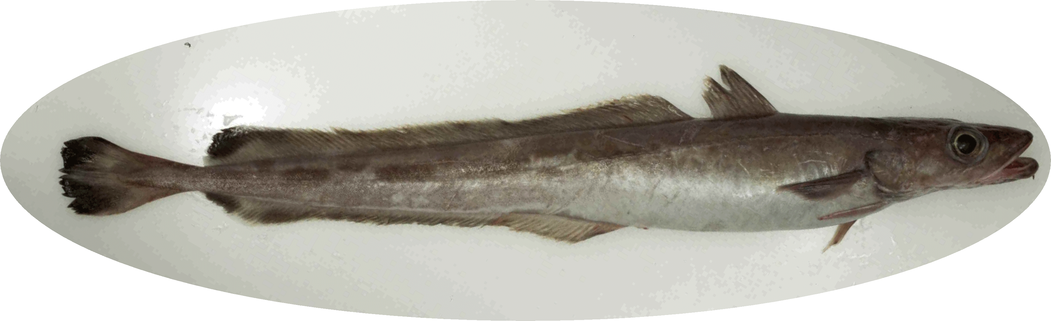
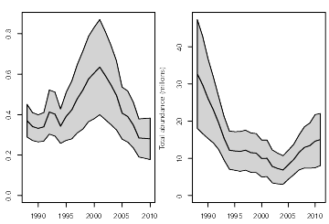
Application to blue ling
Data from commercial fishery
Total catch (t) 1988 - 2011
Numbers-at-length sample data (missing years)
Age-length sample data (missing years)
Total mortality
Abundance
Assumptions
constant catchability ages 9 - 19+
CV(catch) = 0.01

Slide 15
Spatial density modelling
Investigating spatial time trends: local depletion?
Model: landings per haul
log(E[landings]) = s(duration) + s(depth) + s(month) +
soap(eastings, northings, year) + s(depth,month) + s(depth, year)
landings~Tweedie(μ, Φ μ^{1.5})
3D soap smoother
Blue ling
Augustin, N.H., Trenkel, V.M., Wood, N.S., Lorance, P. (under revision) Space-time modelling for blue ling using soap film smoothers. (Environmetrics)
Notes:
Pris de

Slide 16
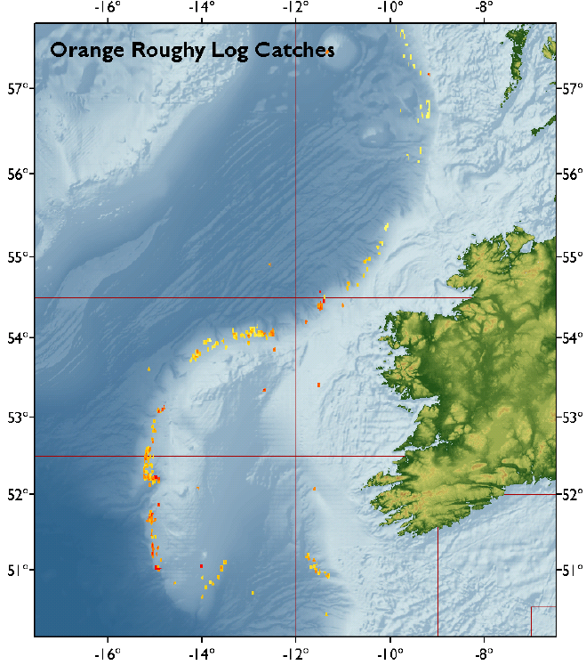
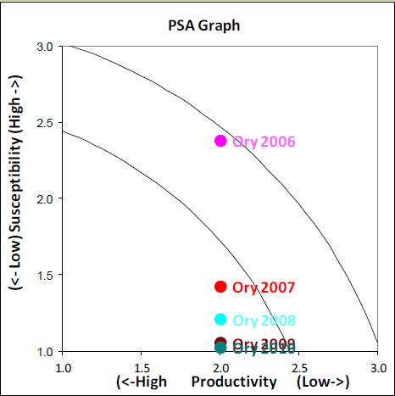
Orange roughy
Productivity Susceptibility Analysis
DATA
- 0n-board observations
Personal log books
Scientific surveys
VMS data of the French and Irish Deepwater fisheries
Low Susceptibillity High
Low
Productivity
Dransfeld, L, Hareide, NR, & Lorance, P. (in prep.) Managing the risk of vulnerable species exposure to deepwater trawl fisheries- The case of Orange Roughy to the west of Ireland and Britain. (DEEPFISHMAN Special Issue)

Slide 17
Trade-offs in blue ling fishery management objectives
Objective | Management measure | Trade-off
Exploit target stocks at MSY | TAC | Mixed fisheries
Protect vulnerable or depleted species | Ban sharks landings
Prevent overfishing | Seasonal closure of spawning areas | Swept area Shark discards
Minimise the effect of bottom fishing on the seafloor | Sedimentary seafloor: None VMEs: spatial closure | Catch rates and benthic production
P. Lorance. (2012) Continental slope fisheries and conservation of vulnerable fish species and deep-water benthic communities: Implications for management (World Fisheries Conference, Edimburgh, Scotland, 7-11 May 2012

Slide 18
Summary of DEEPFISHMAN assessment methods
Method | Application test | Stock assessment
Multi-annual year class curves ∗∗ | Blue ling Roundnose grenadier | BLI West of B.I. (WGDEEP 2012)
State-space life-stage model ∗ | Black scabbardfish Deep-sea sharks | BSF (WGDEEP 2012)
Reconstructed time series of recruitment ∗∗ | Beaked redfish | RED (WKRED 2012; AFWG 2012)
Account of discards ∗∗ Bayesian production model ∗ | Roundnose grenadier | RNG West of B.I. (WGDEEP)
Test of assessment methods ∗ | BLI, RNG, BSF, SBR
GADGET toolbox | Icelandic blue ling | BLI Iceland (WGDEEP 2012)
Seasonal events in abundance ∗∗ | Greater forkbear
Productivity susceptibility Analysis (PSA) ∗ | Orange roughy
Standardizing CPUEs using GAMs ∗∗ | BLI, BSF, RNG | W. of B.I. (WGDEEP)
Likelihood method for identifying joint time trends in multiple time series ∗ | Blue ling, B. scabbardfish, R. grenadier sharks
Spatial density modelling ∗∗ | Blue ling
Community level size-based indicators ∗ | Deep-sea W of B.I.

Slide 19
Conclusion of assessment methods
Deep-water stocks are not all data-poor
Several methods were developed or adapted for DEEPFISHMAN case studies: already used for ICES advice for 5 stocks
DEEPFISHMAN assessment methods provide estimates of fishing mortality and absolute biomass for 4 stocks
Spatial analysis complement stock assessment
Survey data are not required by all assessment methods

Slide 20
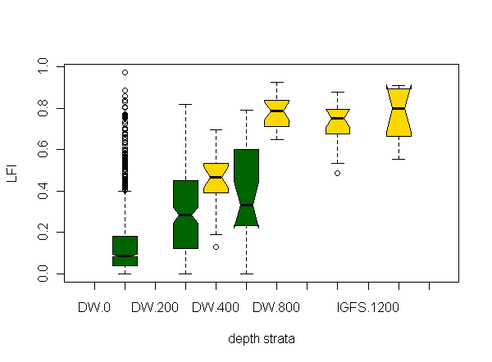
Towards an ecosystem approach: multi-species sustainability indicators
Community indicators under different fishing scenarios
Large fish Indicators from Irish IBTS and Deepwater surveys: increase with depth
Even fishing
DCF large fish indicator
Balanced fishing
Targeted fishing
Dransfeld ,L., et al. (in prep.) Adapting ecosystem indicators to evaluate good environmental status to deepwater fish communities. (DEEPFISHMAN Special Issue)
Blanchard, J.L., Trenkel, V.M., Scott, F., Lorance, P., (in prep.) Assessing the impacts of fisheries on deep-sea target and non-target species: insights from a trait-based multi-species model

Slide 21
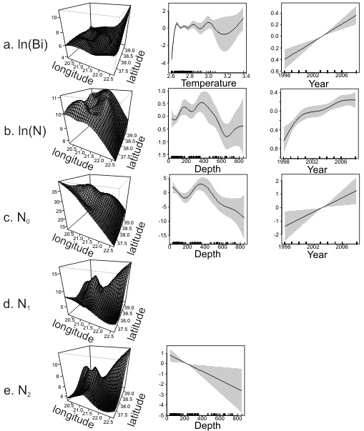
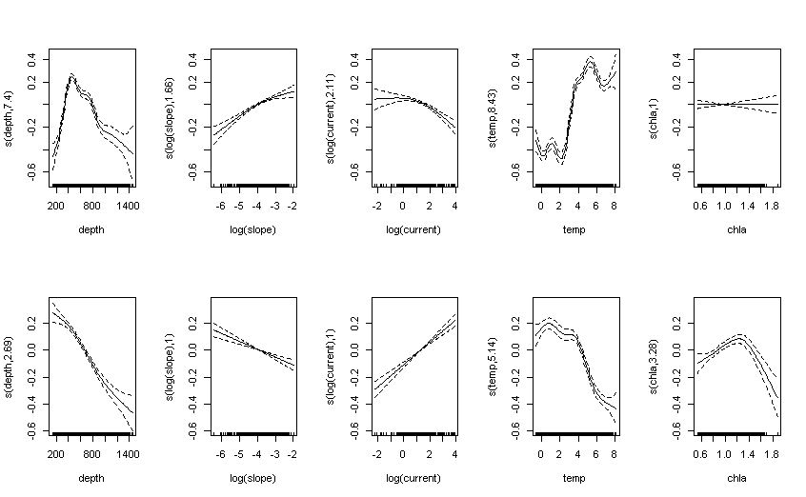
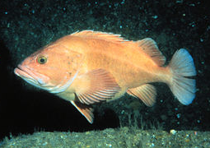
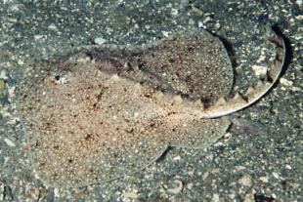
Towards an ecosystem approach:
understanding environmental effects
Deepwater redfish
Depth
Slope
Current
Temp.
Chla
Thorny skate
Roberts, J. et al. (in prep.) Fish diversity and environment: how do deep-water fish communities respond to abiotic gradients and are predictive models of species diversity useful for management? (DEEPFISHMAN Special Issue)
Tsagarakis K.et al. (submitted). Biodiversity, community and population indicators of the Ionian Sea demersal assemblages (Eastern Mediterranean): relation to environmental, spatial, temporal and fisheries factors and management implications, (ICES journal of Marine Science)

Slide 22
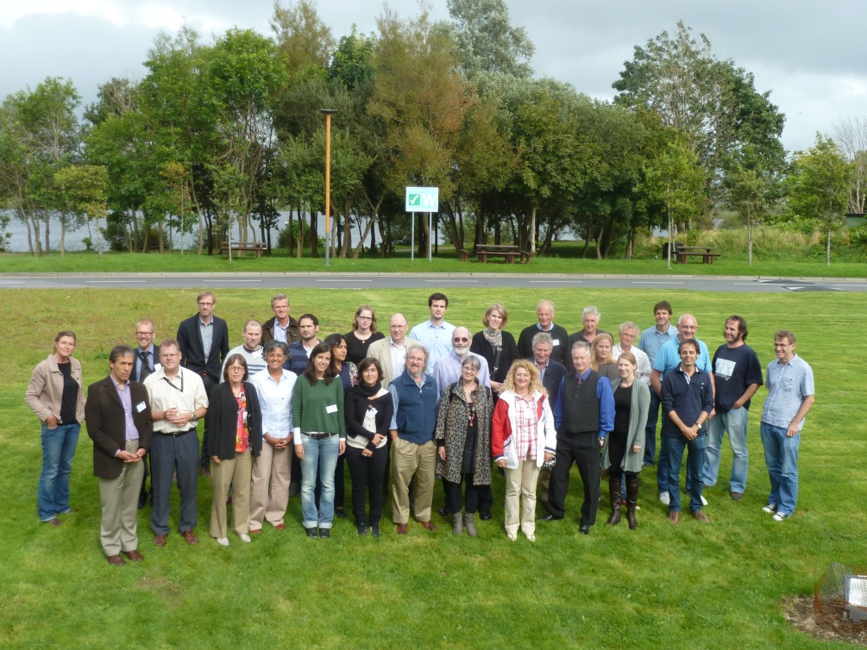
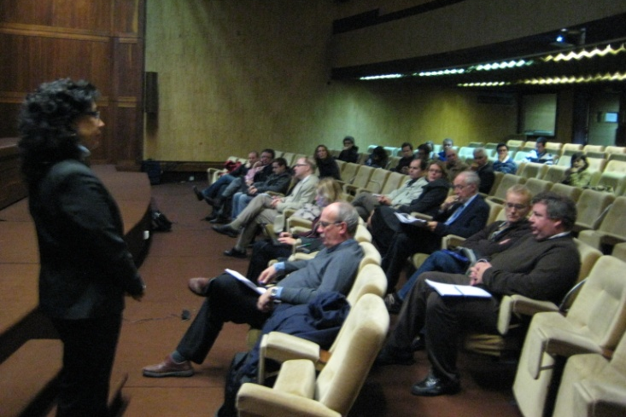
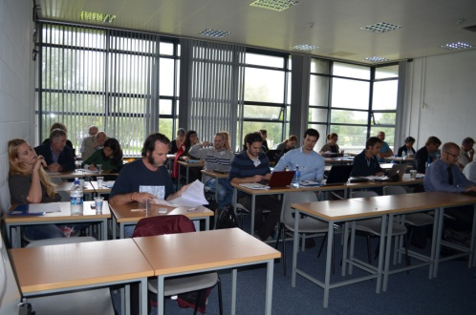
Stakeholder process in DEEPFISHMAN
Workshop in Brussels, 29-30 June 2009
  DEEPFISHMAN stakeholder identification
  SWOT analysis of existing management measures
Workshop in Lisbon, 4 December 2009
  Cognitive maps of case study fisheries
Workshop in Lisbon, 4 July 2011
  Stakeholder contribution to model development
Questionnaires
Haul-by-haul catch and effort data provided by stakeholders
Final workshop, 31 August 2012, NUIG, Galway, Ireland (with CoralFISH)
  Presentation of the management and monitoring framework to stakeholders

Slide 23
Management and monitoring framework
Approach
A review analysis in 20 topics
Some quantitative analyses
Stakeholder consultation
Selected topics of the monitoring and management framework
For licensing purposes the species listed in Annex I and II of 2347/2002 be combined, that Conger conger, Lepidopus caudatus and Sebastes viviparus be deleted and Greenland halibut, tusk and beaked redfish be included
Harmonization of the NEAFC and EU lists of species

Slide 24
Selected topics of the monitoring and management framework
The list of species managed by TACs may need to be expanded. However, for species landed in small quantities a concept of precautionary TAC is currently lacking
Some species that may be considered are:
Common mora (Mora moro) ;
Rabbitfish (Chimaera monstrosa and Hydrolagus spp);
Baird’s smoothhead (Alepocephalus bairdii);
Wreckfish (Polyprion americanus);
Bluemouth (Blackbelly rosefish) (Helicolenus dactylopterus);
Black (deep-water) cardinal fish (Epigonus telescopus);
Deep-water red crab (Chaceon (Geryon) affinis)
The periodicity of TAC revision could be expanded for some species
orange roughy: every 5 years
deep-water sharks: every 5 years
roundnose grenadier: every 3 years
beaked redfish: every 3 years
all other deep water species: every 2 years

Slide 25
Selected topics of the monitoring and management framework
Scientific surveys are useful for species not landed (e.g. sharks). The ICES proposals for fishery independent surveys for the NE Atlantic deep water stocks be adopted by the new DCF
In some fisheries haul-by-haul data were shown highly useful to produce abundance indices
For the need of fisheries and stocks assessment, deep-water fishing intensity to be estimated from VMS
Appropriate VMS data should be made available

Slide 26
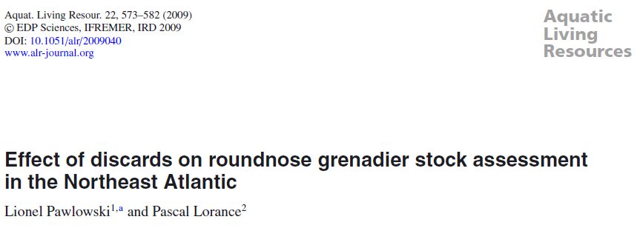


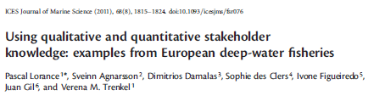
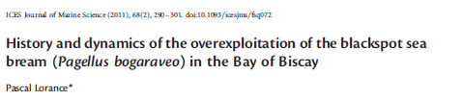
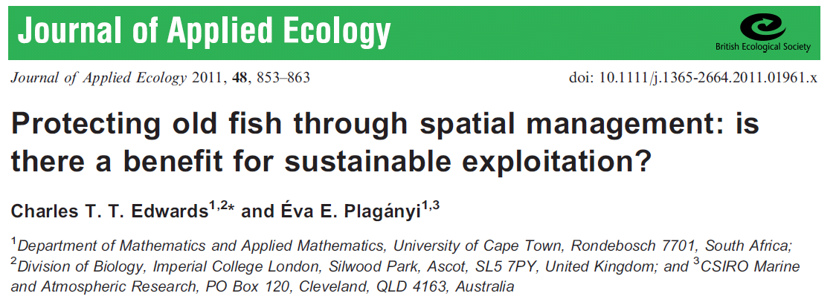
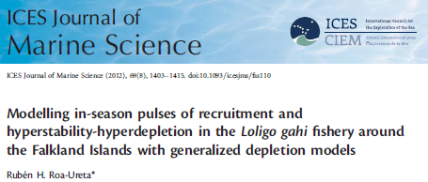
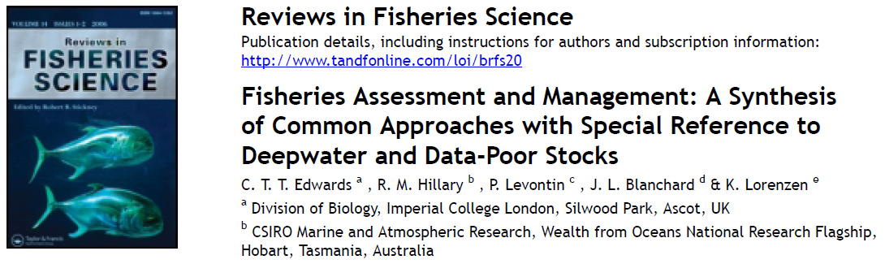
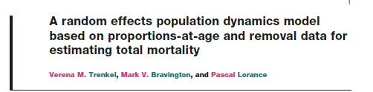
Publications
8 published papers 4 papers under revison/submitted Special issue in preparation

Slide 27
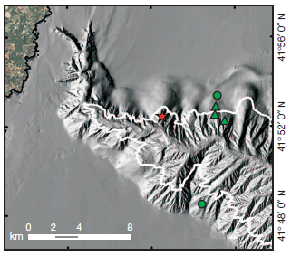
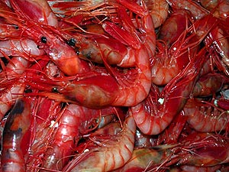
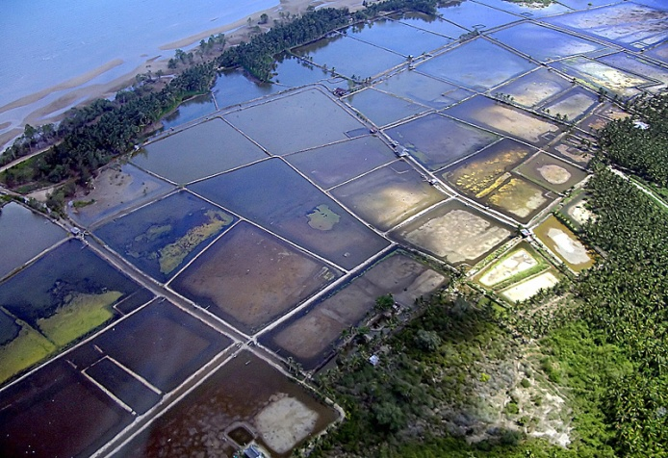
Future research needs
Ecosystem impacts and seafood production
Food supply chain analysis
Compare deep-water fisheries:
Environmental impacts
Energy intensity
Economic efficiency
to other seafood productions (capture and aquaculture)
Puig et al., (2012)
Photos courtesy Jorge Keller / www.buceo-virtual.com
PhotosSebastien Blanc/AFP/Getty Images
Mediterranean blue and red deep-sea shrimp:
-impact on bottom habitat
Tropical shrimp ponds:
- impact on mangrove
Notes:
Puig: showed impact of a fishery for A antennatus. There are important fisheries fro mainly 3 species of deep-sea shrimps in the Mediterranean sea.
Puig et al., 2012. Ploughing the deep sea floor. Nature
Impact of deep-sea trawling
Deep-sea shrimp (A. antennatus, A foliacea, P. longirostris)
17,600 t (FAO); 10-50€/kg (Maynou et al. 2006; Guilen et al. 2012)
What would replace deep-water shrimp on European market?

Slide 28
Future research needs
Spatial data repository for VMEs and fishing ground (VMS data) distributions (need for an internationally coordinated data system)
Ecosystem management taking account of trade-offs, e.g. between conservation and fishery management
Objective | Management measure | Trade-off
Exploit target stocks at MSY | TAC | Mixed fisheries
Protect vulnerable or depleted species | Ban sharks landings
Prevent overfishing | Seasonal closure of spawning areas | Swept area Shark discards
Minimise the effect of bottom fishing on the seafloor | Sedimentary seafloor: None VMEs: spatial closure | Catch rates and benthic production

Slide 29
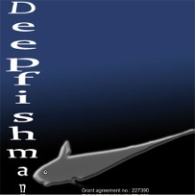












Acknowledgements
Presentation uses material from all DEEPFISHMAN partners and the stakeholder consultation process
Thanks to stakeholders contributing to workshops and responding to questionnaires
Project material on http://deepfishman.hafro.is/

